Slide 1
PART 4
DATA STORAGE AND QUERY

Slide 2

Chapter 11
Indexing and Hashing

Slide 3
Basic Concepts
Ordered Indices
Static Hashing
Dynamic Hashing
Comparison of Ordered Indexing and Hashing
Index Definition in SQL

Slide 4









Contents in This Chapter
Basic concepts and classification of indexing
  ordered indices, hash indices
Properties/types of ordered indices
  primary/clustering indices, secondary/non-clustering indices
  dense indices, sparse indices
  single-level indices, multi-level indices (e.g. B⁺-tree, B-tree)
Hash indices
  hash functions
  static hash, dynamic hash

Slide 5
目 标
学会正确建立、管理索引，提高数据访问速度
  索引类型
  select、insert、update时的索引管理
了解索引对select/update/insert/delete的影响

Slide 6
Category of Indices
Indices
index file
hash function
Ordered indices
Hashing indices
Primary indices
Secondary indices
dense
index
sparse
index
multi-level
index
balance-tree
index
dense
index
稠密索引
稀疏索引
B-tree
index
B⁺-tree
index
static
hashing
dynamic
hashing
顺序索引， 散列索引
主索引（聚集索引），辅助索引（非聚集索引）

Slide 7









§11.1 Basic Concepts
How to locate tuples/records in DB file quickly?
Indexing (索引技术) mechanisms
  used to speed up access to desired data
  e.g. for relation instructor(ID, name, dept_name, salary)
  shown in Fig.11.1, the index
  dept_name → physical address of record (i.e.tuple) in DB file instructor
Search Key
  attributes or a set of attributes used to look up the records in a file
  e.g. dept_name

Slide 8


instructor(ID, name, dept_name, salary)
logical file
instructor
index file
indexed file
Note: the file instructor is logically a sequential file, but its records may be stored non-contiguously or non-ordered on the disk
76766
98345
58583
physical
file instructor
10101
12121
15151
45565
76543
22222
83821
32343
33465
Fig. 11.1 DB indexed file instructor and its index file

Slide 9

Basic Concepts (cont.)
An index file consists of records (called index entries索引条目) of the form
Index files are typically much smaller than the original file
Indexing
  mapping from search-key to storage locations of the file records,
  i.e. search-key → storage locations of the records in disks
search-key
pointer

Slide 10

ordered indices
hash indices
{索引项}
index entry
r(R), R (A, B, S, …. , , D)
a₁
b₁
s₁
…
d₁
a₂
b₂
s₂
…
d₂
h(s₁)
s₁
s₂
s₃
.
.
s_{i}
.
.
s_{j}
.
s_{n}
a₃
b₃
s₃
…
d₃
s₁
s₂
s₃
.
.
s_{i}
.
.
s_{j}
.
s_{n}
s₁
s₂
s₃
…
s_{i}
…
s_{m}
…
…
…
…
…
…
a_{i}
b_{i}
s_{i}
…
d_{i}
…
…
…
…
…
h(s_{i})
散列
函数H
a_{j}
b_{j}
s_{j}
…
d_{j}
…
…
…
…
…
…
…
a_{m}
b_{m}
s_{m}
…
d_{m}
…
…
…
…
…
…
a_{n-1}
b_{n-1}
s_{n-1}
…
d_{n-1}
h(s_{n})
a_{n}
b_{n}
s_{n}
…
d_{n}
搜索键
(search key)
搜索键
(search key)
索引文件
(index file)
数据文件
（主文件、被索引文件indexed file）
图 11.0.1 索引 (indexing)及其分类

Slide 11


Basic Concepts (cont.)
Two basic kinds of indices:
  ordered indices: the index file is used to store the index entries in which the search key of the records and the address of the records are stored in sorted order
  hash indices: the “hash function” is used to map the the search key of the records to the address of the records
  the records are stored in the “buckets”, the number of the bucket is as the address of the records and is determined by the hash function

Slide 12


Basic Concepts (cont.)
Access types supported efficiently. E.g.,
  records with a specified value in the attribute
  or records with an attribute value falling in a specified range of values.
Access time
Insertion time
Deletion time
Space overhead（空间开销）
Notes:
用于索引评价的几个要素：
Access time（访问时间）：用该技术找到一个特定数据项或数据项集所需的时间。
Insertion time（插入时间）：插入一个新数据项所需时间。这个值包括找到插入这个新数据项的正确位置所需的时间和更新索引结构所需的时间。
Deletion time（删除时间）：删除一个新数据项所需时间。这个值包括找到待删除项所需的时间和更新索引结构所需的时间。
Space overhead（空间开销）：一个索引结构所占用的额外存储空间。

Slide 13

§11.2 Ordered Indices
DBS files with indexing mechanism include two parts :
  indexed file, in which data records are stored
  index file, in which index entries are included
  e.g. Fig.11.1
The indexed file can be organized as
  sequential file
  heap file
  hash file
  clustering file

Slide 14
Ordered Indices (cont.)
Ordered index (in index file)
  the index entries in the index file are stored in some sorted order, for instance, in accordance with the order of the search key
  /* 索引项的排列顺序与(被索引文件中)搜索键的排列顺序一致
  e.g. in Fig.11.1( ) , the index file is sorted by dept_name

Slide 15
instructor(ID, name, dept_name, salary)
logical file
instructor
index file
indexed file
Note: the file instructor is logically a sequential file, but its records may be stored non-contiguously or non-ordered on the disk
76766
98345
58583
physical
file instructor
10101
12121
15151
45565
76543
22222
83821
32343
33465
Fig. 11.1 DB indexed file instructor and its index file

Slide 16

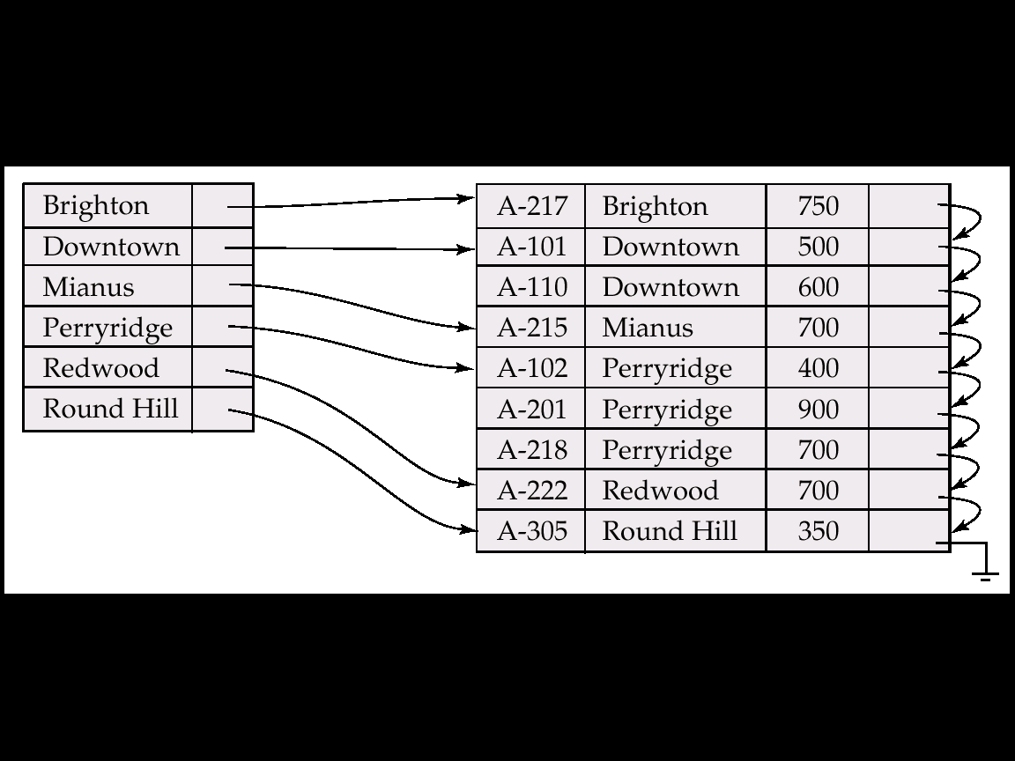
(account-number, branch-name, balance)
logical
file account
index file
indexed file
DB indexed file account and its index file

Slide 17
§11.2.1 Primary and Secondary Indices
Primary/clustering index (in the index file)
  considering a index file and its corresponding indexed file.
  the indexed file is a sequential file, and the index whose search key also specifies the sequential order of the indexed file
  /* 索引文件的搜索键所规定的顺序与被索引的顺序文件中的记录顺序一致
  e.g. in Fig.11.1 , (dept_name, address of records) defines the same orders of the records as that in sequential indexed file instructor
  note: also called clustering index

Slide 18

Primary and Secondary Indices (cont.)
The search key of a primary index is usually but not necessarily the primary key
  e.g. in Fig. 11.1, dept-name is not the primary key of instructor

Slide 19
Primary（主索引）/clustering index（ 聚集索引）(in index file)
  considering a index file and its corresponding indexed file.
  if the indexed file is a sequential file, and the search key in index file also specifies the sequential order of the indexed file
  /* 索引文件的搜索码所规定的顺序与被索引的顺序文件中的记录顺序一致
  如果包含记录的文件按照某个搜索码指定的顺序排序，那么该搜索码对应的索引称为聚集索引。
  e.g. in Fig.11.1, (branch-name, address of records) defines the same orders of the records as that in sequential indexed file account

Slide 20
(account-number, branch-name, balance)
logical
file account
index file
indexed file
Fig. 11.1 DB indexed file account and its index file

Slide 21
Primary and Secondary Indices (cont.)
聚集索引 vs 主索引
  聚集索引：
  索引文件的搜索键所规定的顺序与被索引的顺序文件中的记录顺序一致
  主索引：
  建立在主键（主属性上）的索引
  当一个表定义了主键后，DBMS会自动为该表在主键上建立聚集索引，该索引同时又是主索引

Slide 22
Primary and Secondary Indices (cont.)
  一个表上只能建立一个聚集索引，也只能有一个主索引。
  — why？ 数据文件根据索引项进行排序，只能有一种排列顺序
  但可以建立多个非聚集索引
  如果一个表上没有定义主键，则不会有主索引；但可以为该表建立一个聚集索引
  主索引一定是聚集索引，但聚集索引不一定是主索引

Slide 23

Primary and Secondary Indices (cont.)
  在没有定义主键的关系表中插入数据：
  在关系表所在数据库文件中，各个元组/行/记录顺序一般是无序，取决于数据插入顺序——heap文件
  e.g. select * from tablename
  在有主键的关系表中插入数据：
  数据库文件是有序的，按照主键顺序排列

Slide 24
11.2.4 Primary and Secondary Indices (cont.)
Secondary index
  an index whose search key specifies an order different from the sequential order of the file.
  also called non-clustering index
Secondary indices have to be dense indices
Notes:
辅助索引，也成为非聚集索引

Slide 25



buckets
Secondary index on salary field of instructor
Index record points to a bucket that contains pointers to all the actual records with that particular search-key value.
Secondary indices have to be dense
Notes:
辅助索引必须是稠密的，因为文件记录不是顺序存放的。
利用一个附加的桶（间接指针层）来实现非候选码的搜索码上的辅助索引。

Slide 26

Secondary Indices(辅助索引）
搜索码指定的顺序与文件中记录的物理顺序不同的索引称为非聚集索引或辅助索引。
Frequently, one wants to find all the records whose values in a certain field (which is not the search-key of the primary index) satisfy some condition.
  Example 1: In the account relation stored sequentially by account number, we may want to find all accounts in a particular branch
  Example 2: as above, but where we want to find all accounts with a specified balance or range of balances
We can have a secondary index with an index record for each search-key value
候选码上的辅助索引和稠密聚集索引没有太大的区别，只不过索引中一系列的连接值指向的记录不是顺序存放的。

Slide 27
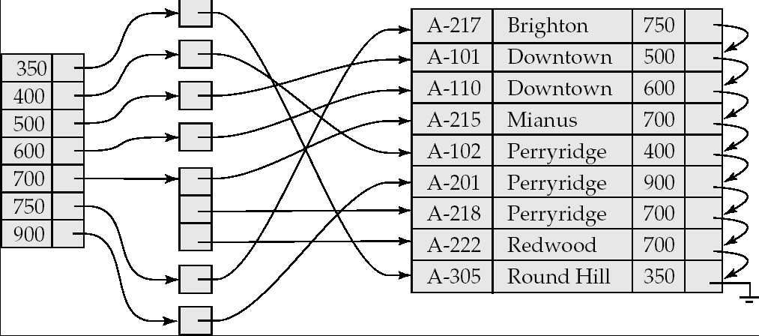
Secondary Indices Example
Secondary index on balance field of account
用一个附加的间接指针层来实现非候选码的搜索码上的辅助索引
Index record points to a bucket that contains pointers to all the actual records with that particular search-key value.
Secondary indices have to be dense

Slide 28

11.2.1 Dense and Sparse Indices
Dense index
  the index record in the index file appears for every search-key value in the indexed file（文件中的每个搜索码值有一个索引记录）
  each value of search-key in the indexed file corresponds to an index entry in the index file
  e.g. Fig.11.1
  dense index on dept_name, with instructor file sorted on dept_name

Slide 29
Dense and Sparse Indices
In a dense primary index, the index record contains the search-key value and a pointer to the first record with that search-key value
  the rest of the records with the same search-key value would be stored sequentially after the first record
  e.g. Fig.11.1, search-key value “Comp.Sci” corresponds to three records in the file

Slide 30
instructor(ID, name, dept_name, salary)
logical file
instructor
index file
indexed file
Note: the file instructor is logically a sequential file, but its records may be stored non-contiguously or non-ordered on the disk
76766
98345
58583
physical
file instructor
10101
12121
15151
45565
76543
22222
83821
32343
33465
Fig. 11.1 DB indexed file instructor and its index file

Slide 31
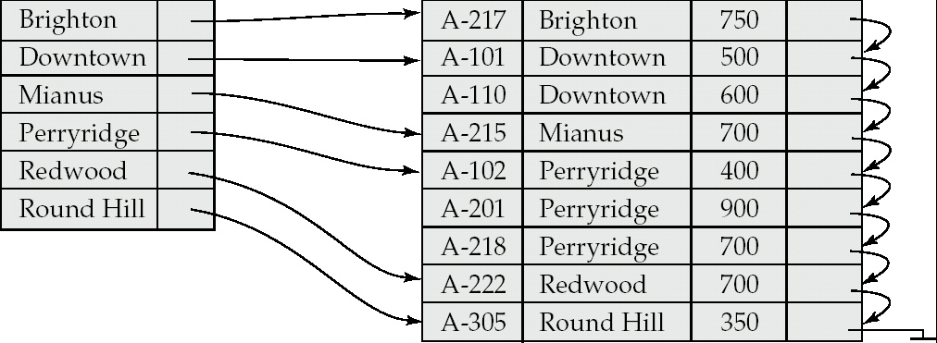
Dense Index Files(稠密索引文件）
DB indexed file account and its index file

Slide 32
Dense and Sparse Indices (cont.)
Sparse Index
  index file contains index entries for only some search-key values in the indexed file（只为搜索码的某些值建立索引记录）
  e.g. Fig.11.3
To locate a file record with search-key value K
  find index entry with largest search-key value ≤ K
  search file sequentially starting at the record to which this index entry points

Slide 33


Dense and Sparse Indices
index file
indexed file
Fig.11.3 Sparse index for the file instructor

Slide 34
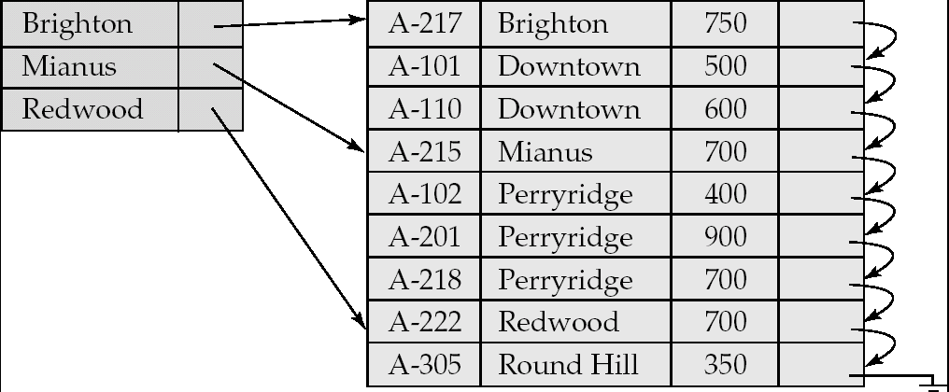
Sparse Index Files（稀疏索引文件）

Slide 35
Sparse Index Files (Cont.)
Compared to dense indices:
  Less space and less maintenance overhead(开销） for insertions and deletions.
  Generally slower than dense index for locating records.
Good tradeoff（权衡）: sparse(稀疏） index with an index entry for every block in file, corresponding to least search-key value in the block.(减小空间开销）
为每个块建一个索引项的稀疏索引是一个较好的折中。

Slide 36
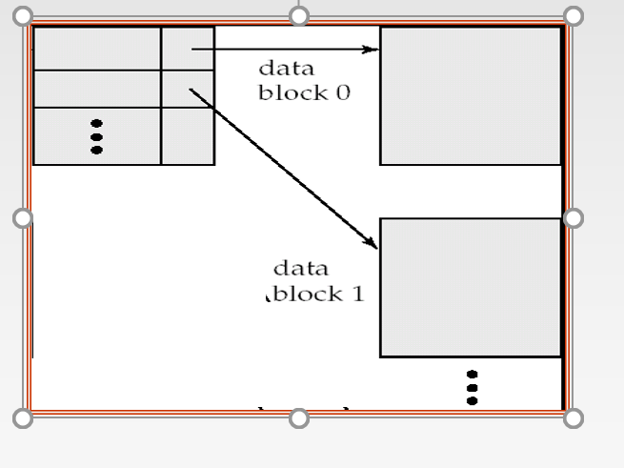
Sparse Index Files (Cont.)

Slide 37
Primary vs Secondary Indices
Indices offer substantial benefits when searching for records.
BUT:
Updating indices imposes overhead on database modification --when a file is modified, every index on the file must be updated
Sequential scan using primary index is efficient, but a sequential scan using a secondary index is expensive
  Each record access may fetch a new block from disk
  Block fetch requires about 5 to 10 milliseconds（毫秒）, versus about 100 nanoseconds（纳秒） for memory access

Slide 38
11.2.2 Multi-level Indices
The index file may be very large, and cannot be entirely kept in memory
If primary index does not fit in memory, access becomes expensive.
Solution: treat primary index kept on disk as a sequential file and construct a sparse index on it.
  outer index – a sparse index of primary index file
  inner index – the primary index file
If even outer index is too large to fit in main memory, yet another level of index can be created, and so on.

Slide 39
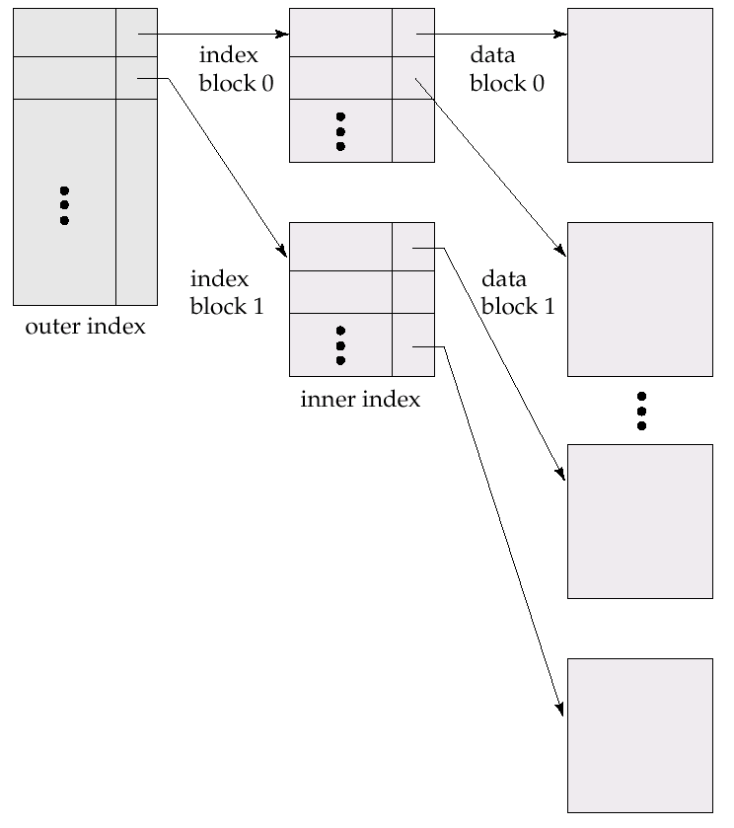
B⁺-tree indices and B-tree indices are two types of efficient multi-level indices, and widely used in DBS file systems
index file
Fig. 11.5
Two-level sparse index
Note: similar to hierachical page tables or file indexs in OS
indexed file
Notes:
Inner index: 内层索引，主索引，放在disk上；
Outer index：外层索引，稀疏索引，放在主存中

Slide 40
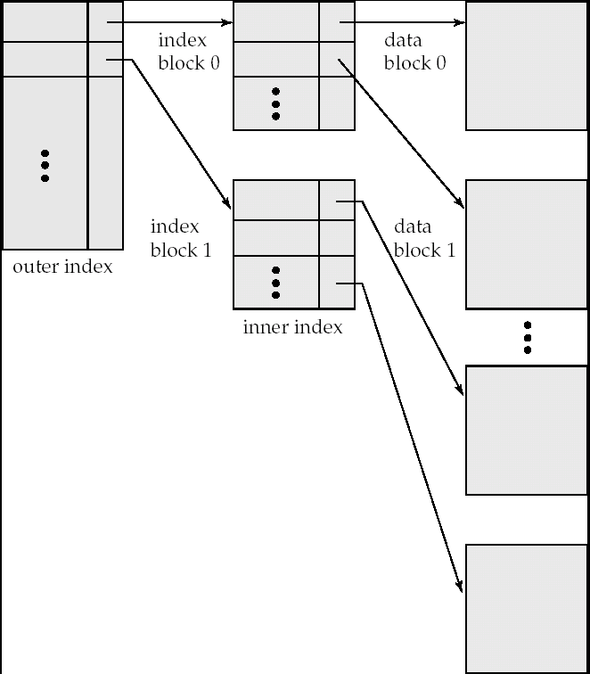
Multilevel Index (Cont.)
外层索引
稀疏索引
内层索引
主索引
index file
indexed file

Slide 41
11.2.5 Indices on Multiple Keys
Composite search keys are search keys containing more than one attribute
  E.g. (dept_name, salary)
Lexicographic ordering （字典序） : (a₁, a₂) < (b₁, b₂) if either
  a₁ < b₁, or
  a₁=b₁ and a₂ < b₂
  E.g.
  create index Mutiple-index on takes(course_id, semester, year )

Slide 42
§11.5/6 Hashing Index Files
The file records are stored in a set of buckets
  a bucket is a unit of storage containing one or more records (a bucket is typically a disk block).
Hash function h
  a function from the set of all search-key values K in a file to the set of all bucket addresses, i.e. the set of the addresses of file records
  typical hash functions perform computation on the internal binary representation of the search-key.
Hash file organization
  obtaining the bucket of a record directly from its search-key value using a hash function

Slide 43
11.8 Comparison of
Ordered Indexing and Hashing
Expected type of queries:
  Hashing is generally better at retrieving records having a specified value of the key, e.g. ID=10121
  If range queries are common, e.g. age between 17 and 25, ordered indices are to be preferred
In practice:
  PostgreSQL supports hash indices, but discourages use due to poor performance
  Oracle supports static hash organization, but not hash indices
  SQLServer supports only B⁺-trees

Slide 44
Static Hashing(静态散列）
A bucket （桶）is a unit of storage containing one or more records (a bucket is typically a disk block). （存储一条或多条记录的一个存储单位）
In a hash file organization (散列文件组织）we obtain the bucket of a record directly from its search-key value using a hash function.（计算所需记录搜索码值的函数直接获得包含该记录的磁盘块地址）
Hash function h is a function from the set of all search-key values K in a file to the set of all bucket addresses B, i.e. the set of the addresses of file records
散列函数是一个从K 到B的函数
  typical hash functions perform computation on the internal binary representation of the search-key.

Slide 45
Static Hashing(cont.) (静态散列）
Hash function is used to locate records for access, insertion as well as deletion.
Records with different search-key values may be mapped to the same bucket; thus entire bucket has to be searched sequentially to locate a record.

Slide 46
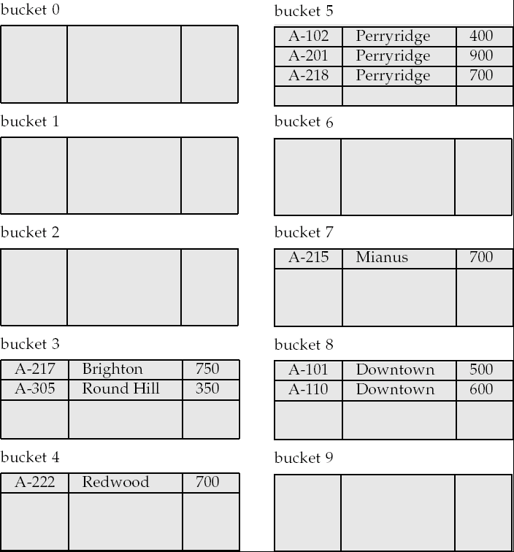
Example of Hash File Organization
Hash file organization of account file, using branch_name as key
Hash function:
returns the sum of the binary representations of the characters modulo（以..为模）10

Slide 47
Hash Functions
Worst hash function maps all search-key values to the same bucket; this makes access time proportional to the number of search-key values in the file.
An ideal hash function is uniform（均匀的）, i.e., each bucket is assigned the same number of search-key values from the set of all possible values.
Ideal hash function is random（随机的）, so each bucket will have the same number of records assigned to it irrespective（无关的） of the actual distribution of search-key values in the file.

Slide 48
Hash Functions
Typical hash functions perform computation on the internal binary representation of the search-key.
  For example, for a string search-key, the binary representations of all the characters in the string could be added and the sum modulo （以..为模）the number of buckets could be returned.
  Modulo：两个数值相除并返回其余数。
  散列函数先计算码中字符的二进制表示的总和，然后返回该总和取桶数目的模。

Slide 49
Handling of Bucket Overflows（桶溢出处理）
Bucket overflow can occur because of
  Insufficient buckets
  Skew （偏斜）in distribution of records. This can occur due to two reasons:
    multiple records have same search-key value
    chosen hash function produces non-uniform distribution of key values
Although the probability of bucket overflow can be reduced, it cannot be eliminated; it is handled by using overflow buckets.

Slide 50
Handling of Bucket Overflows (Cont.)
Overflow chaining（溢出链） – the overflow buckets（桶） of a given bucket are chained together in a linked list.
一个给定桶的所有溢出桶用一个链接列表链接在一起，使用这种链接列表的溢出处理称为溢出链。
Above scheme is called closed hashing（闭散列）.
  An alternative, called open hashing（开散列）, which does not use overflow buckets, is not suitable for database applications.

Slide 51
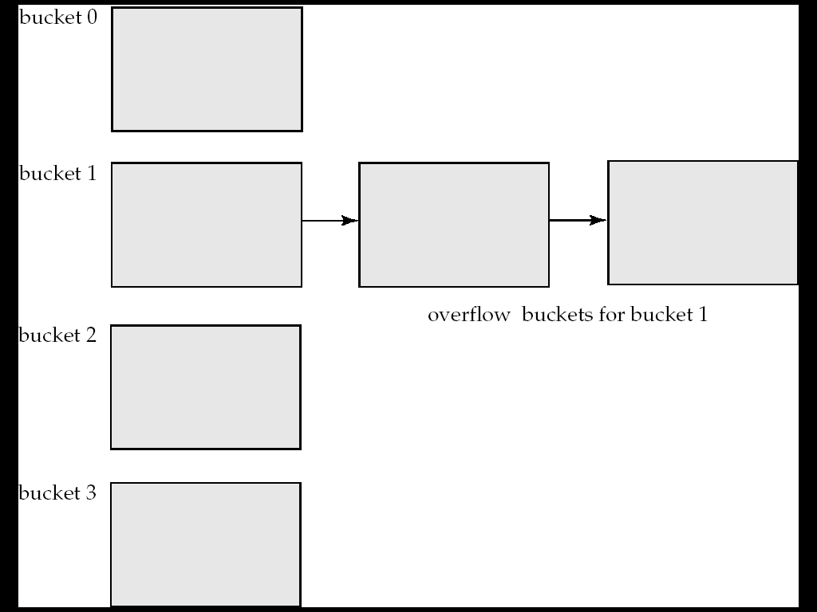
Handling of Bucket Overflows (Cont.)
Fig. 散列结构中的溢出链

Slide 52
Hash Indices（散列索引）
Hashing can be used not only for file organization, but also for index-structure creation.
A hash index organizes the search keys（搜索码）, with their associated record pointers, into a hash file structure.（散列索引将搜索码及其相应的指针组织成散列文件结构）
下图中的散列函数计算帐户各位数字之和后模7。该散列索引有7个桶，每个桶的大小为2

Slide 53
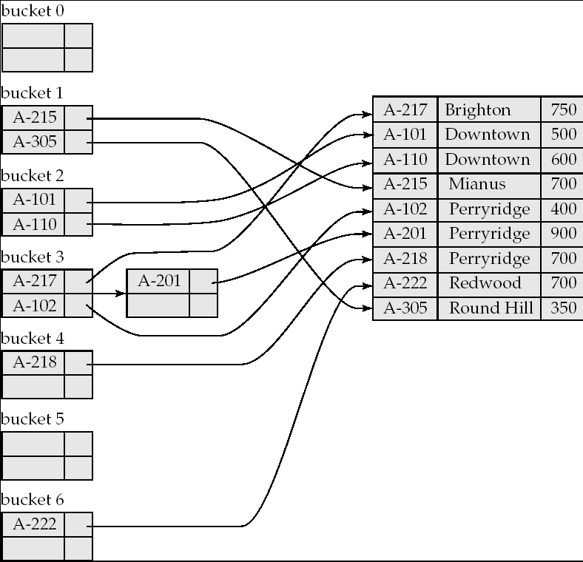
Example of Hash Index

Slide 54
Hash Indices（散列索引）
Strictly speaking, hash indices are always secondary indices
  if the file itself is organized using hashing, a separate primary hash index on it using the same search-key is unnecessary.
  However, we use the term hash index to refer to both secondary index structures and hash organized files.

Slide 55
Static Hashing vs Dynamic Hashing
Static hashing
  hash function h cannot be modified, while being used
Deficiencies（不足）of Static Hashing
  in static hashing, function h maps search-key values to a fixed set of B of bucket addresses
  if databases grow with time, the initial number of buckets may be too small, performance will degrade due to too much overflows
  if database shrinks（收缩）, bucket space will be wasted

Slide 56
Static Hashing vs Dynamic Hashing (cont.)
Dynamic hashing
  hash function h to be modified dynamically
Principles
  hash function generates values over a large range — typically b-bit integers, with b = 32
  at any time use only a prefix（前缀） of the hash function to index into a table of bucket addresses
  let the length of the prefix be i bits, 0 ≤ i ≤ 32
  bucket address table size = 2^{i.} Initially i = 0

Slide 57
Static Hashing vs Dynamic Hashing (cont.)
  value of i grows and shrinks as the size of the database grows and shrinks
  multiple entries in the bucket address table may point to a bucket
  thus, actual number of buckets is < 2^{i}
    the number of buckets also changes dynamically due to coalescing（合并） and splitting（分裂） of buckets.

Slide 58
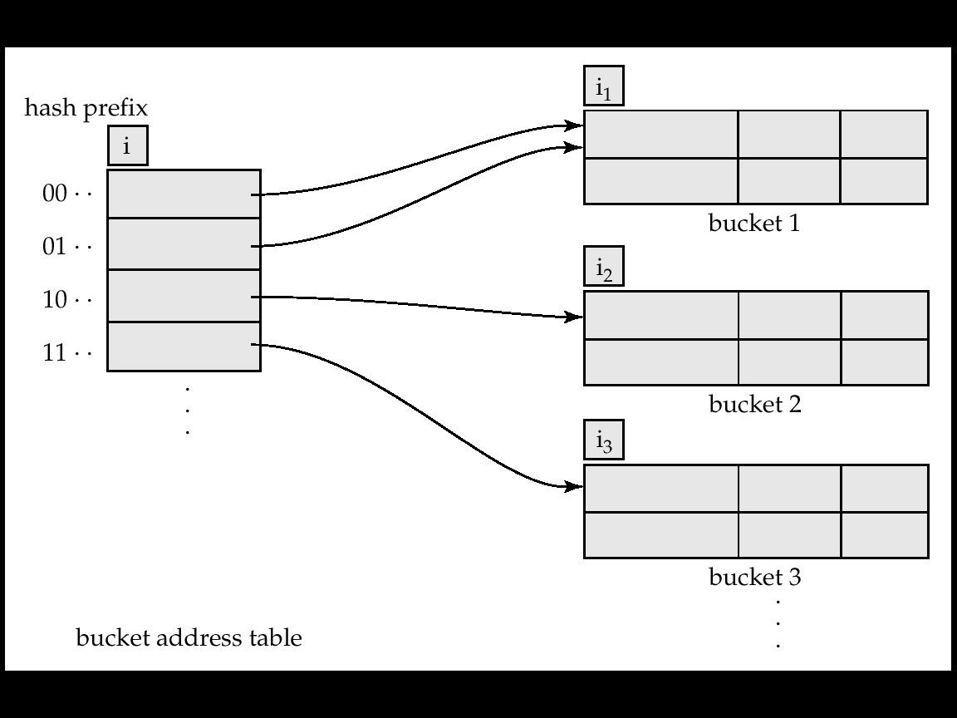
Static Hashing vs Dynamic Hashing (cont.)
Fig. Extendable hash structure

Slide 59
Usage of dynamic hashing
Each bucket j stores a value i_{j} ; all the entries that point to the same bucket have the same values on the first i_{j} bits
To locate the bucket containing search-key K_{j}
  1. Compute h(K_{j}) = X
  2. Use the first i high order bits of X as a displacement （位移）into bucket address table, and follow the pointer to appropriate bucket

Slide 60
Index Definition in SQL
Create an index
  create index <index-name> on <relation-name> (<attribute-list>)
  E.g.: create index b-index on branch(branch_name)
Use create unique index to indirectly specify and enforce the condition that the search key is a candidate key.
Not really required if SQL unique integrity constraint is supported
To drop an index
  drop index <index-name>
Most database systems allow specification of type of index, and clustering.

